Slide 1

Project name : TRAFFIC MANAGEMENT SYSTEM
DEPARTMENT OF INFORMATION TECHNOLOGY
Team name : Proj_224783_Team_7
Team members :
ROSHINI SHREE R(113321205041)
YAMINI G(113321205058)
ELSEY MARGREAT GLADIES A(113321205013)
ROSHA S K(113321205040)

Slide 2
Problem Statement
Traffic congestion problems consist of incremental delay, vehicle operating costs such as fuel consumption, pollution emissions and stress that result from interference among vehicles in the traffic stream, particularly as traffic volumes approach a road's capacity.

Slide 3
Objectives:
Congestion Reduction: The primary objective is to significantly reduce traffic congestion in urban areas, leading to smoother traffic flow and reduced travel times for commuters.
Real-Time Monitoring: Implement real-time monitoring of traffic conditions to enable immediate responses to traffic incidents, accidents, or unexpected road closures.
Data-Driven Decision-Making: Utilize IoT-generated data for informed decision-making in traffic management, signal control, and resource allocation.
Optimized Traffic Flow: Develop algorithms and systems to optimize traffic flow, reducing stop-and-go traffic and improving overall transportation efficiency.
Energy Efficiency: Promote fuel and energy efficiency by minimizing idling time, reducing carbon emissions, and optimizing vehicle routes.
Safety Enhancement: Improve road safety by reducing the likelihood of accidents caused by congestion, erratic driving, or emergency vehicle delays.
Public Awareness: Increase public awareness and engagement in traffic management through user-friendly mobile apps and public information systems.
Emergency Response: Prioritize emergency vehicles' access to roads during emergencies, improving response times and potentially saving lives.

Slide 4
IoT Device Setup:
For the IoT device setup, we will use the following components and sensors:
Traffic Sensors: Inductive loop sensors, ultra sonic sensors,image and camera sensors
Communication Devices: IOT Gateway,Communication Protocols
Traffic Signals: Smart Traffic Lights,VMS, Roadside Display
User Interface: Mobile Apps,Website
Power Supply: Solar Panels,Battery Backup

Slide 5
Platform Development:
Define Requirements: Identify the specific requirements and objectives of the Traffic Management System, as discussed in the problem statement and objectives
Hardware Selection: Choose the necessary IoT devices and sensors, including traffic sensors, communication devices, and control devices.
User Feedback and Improvement: Establish mechanisms for gathering user feedback to make continuous improvements to the system.
Scalability:- Plan for the scalability of the platform to accommodate growing urban populations and expanding transportation networks.
User Training: Train system administrators, traffic management personnel, and support staff on using and maintaining the platform.
Cost Management: Monitor and manage the operational costs associated with the platform.

Slide 6
Python Code
import random
import time
# Simulate IoT device sensors (e.g., traffic flow and vehicle count)
def simulate_traffic_sensor_data():
traffic_flow = random.randint(0, 100)
vehicle_count = random.randint(0, 50)
return traffic_flow, vehicle_count
# Simulate traffic management logicdef traffic_management(traffic_flow, vehicle_count):
if traffic_flow > 70:
if vehicle_count > 30:
return "Traffic is congested. Consider rerouting."
else:
return "Traffic is heavy but manageable."
else:
return "Traffic is light.“
# Main loop for the IoT device
while True:
traffic_flow, vehicle_count = simulate_traffic_sensor_data()
message = traffic_management(traffic_flow, vehicle_count)
print(f"Traffic Flow: {traffic_flow}, Vehicle Count: {vehicle_count} - {message}")
time.sleep(5)

Slide 7
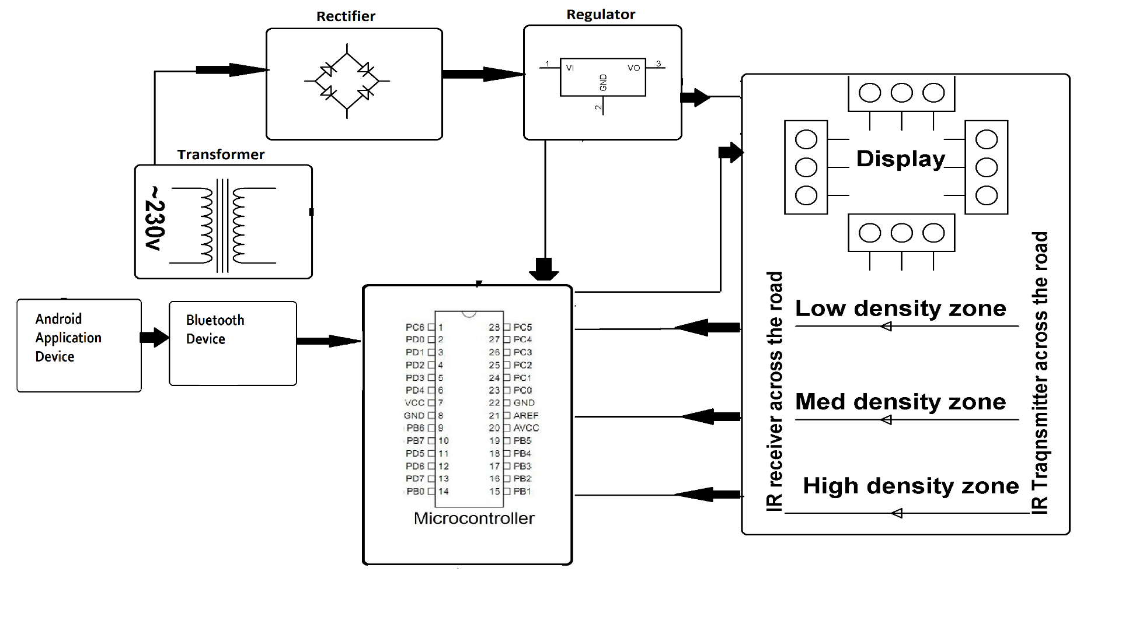
BLOCK DIAGRAM

Slide 8
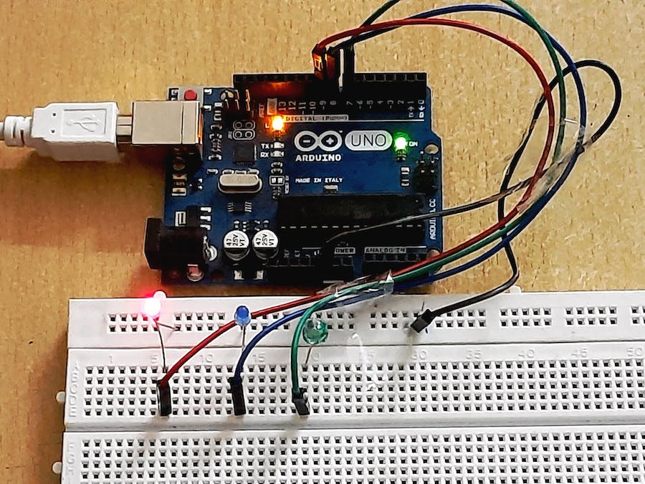
screenshots of the IoT devices

Slide 9
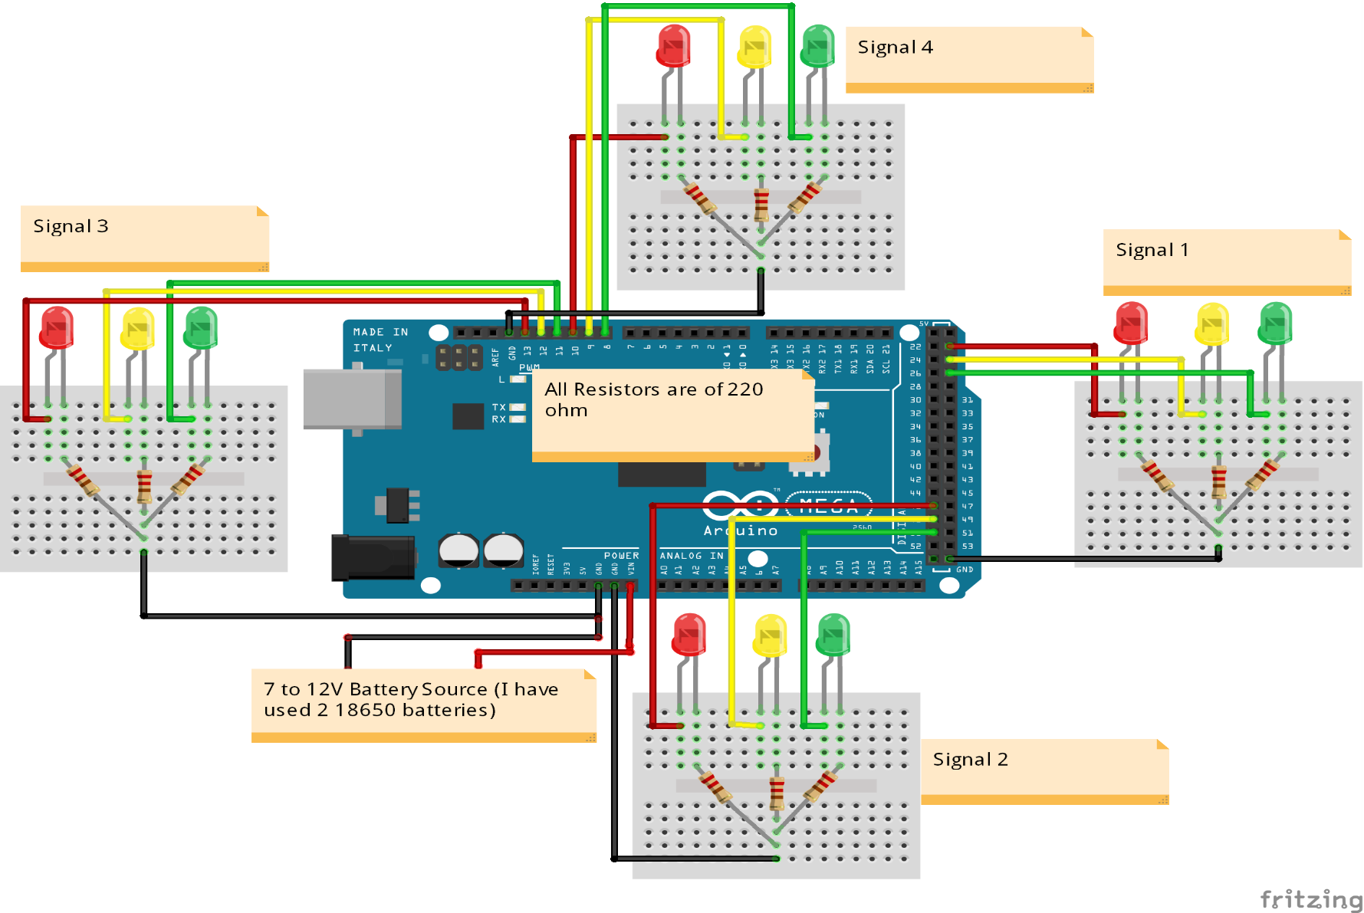

Slide 10
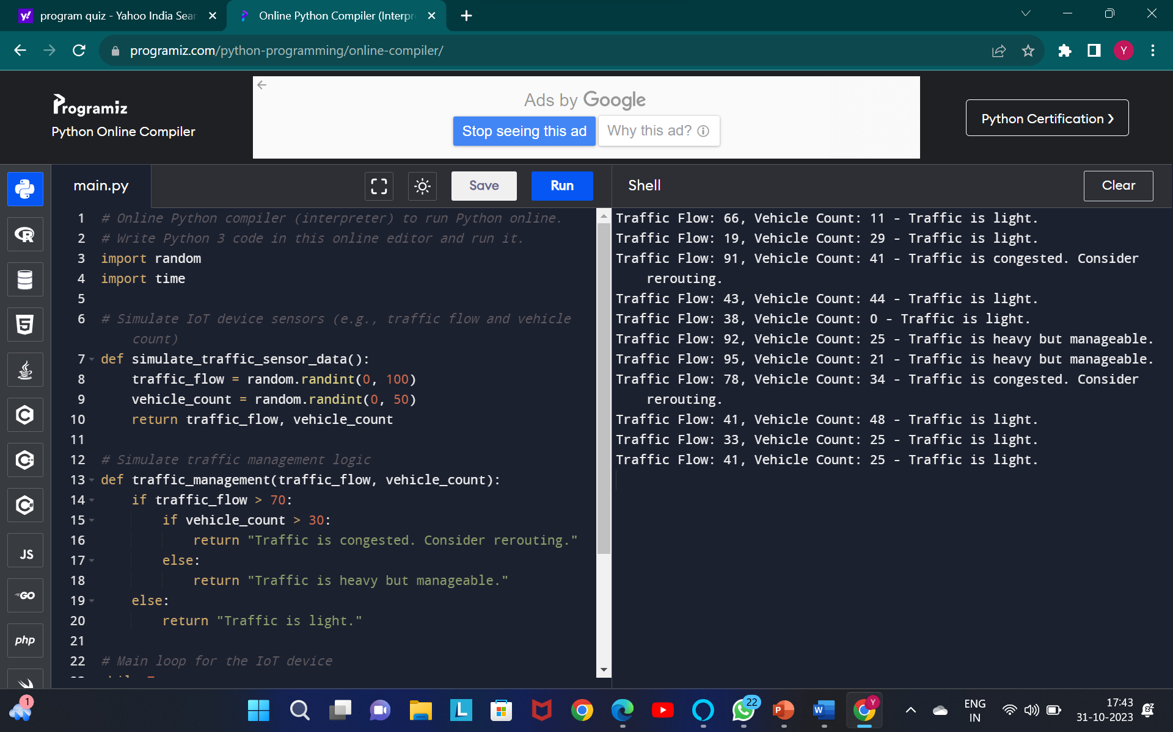
SCREENSHOT OF PYTHON CODE OUTPUT:

Slide 11
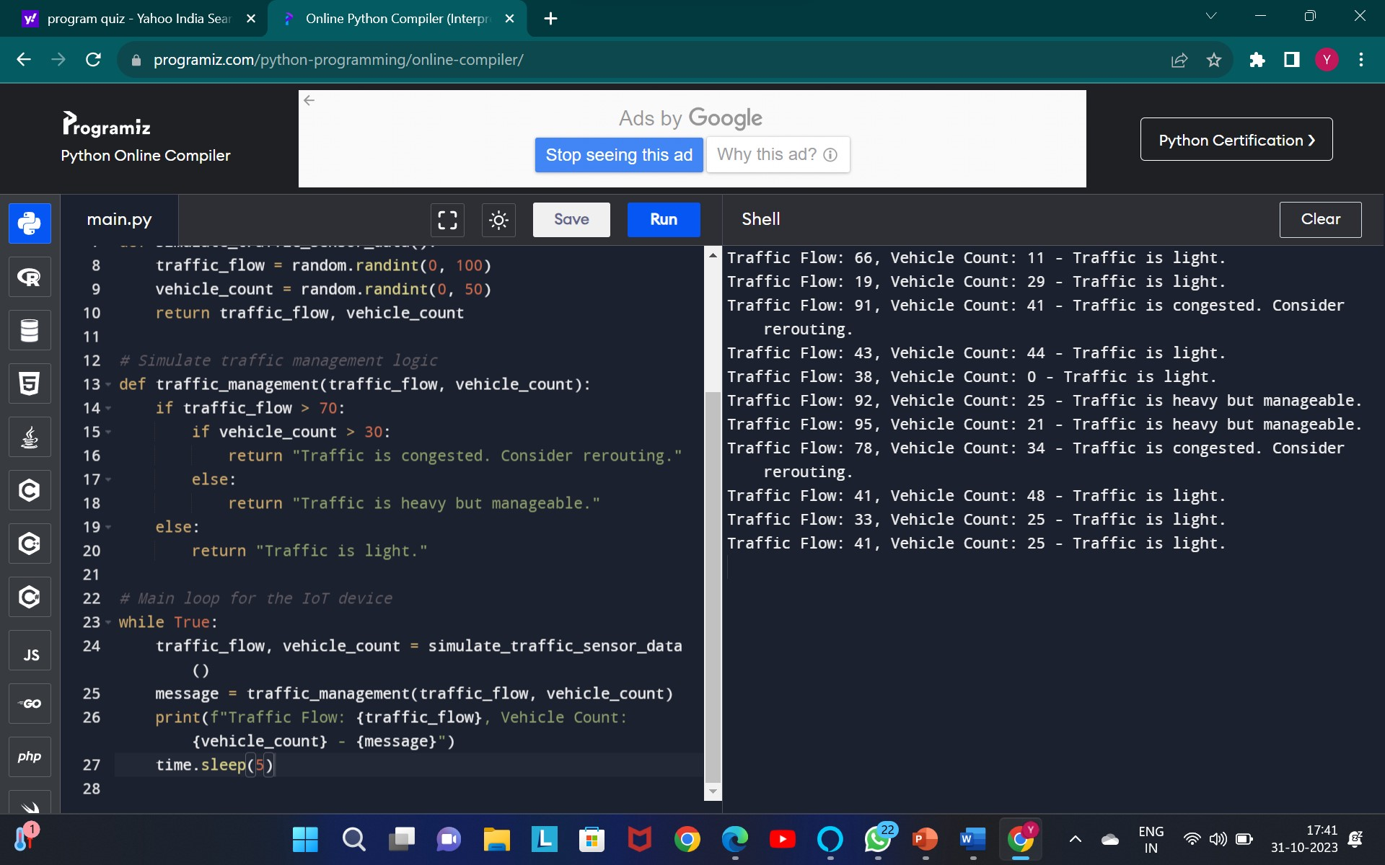

Slide 12
Data Sharing Platform UI:
User Interface (UI): Design a user-friendly interface for traffic management personnel and users. This UI should display real-time data, such as traffic flow, incidents, and weather conditions.
IoT Devices: Deploy IoT devices like cameras, sensors, and traffic lights to collect data. These devices should be connected to the platform via the internet
User Authentication: Implement secure user authentication to control access to sensitive traffic data.
Traffic Control: Integrate the platform with traffic control systems to enable dynamic traffic signal adjustments based on real-time data.
Real-time Updates: Ensure that the platform can provide real-time updates to traffic management personnel. Use push notifications or real-time dashboards.

Slide 13
EXPLANATION
a Traffic Management System in IoT transforms urban traffic management by harnessing data and real-time communication to reduce congestion, improve transportation efficiency, enhance safety, and promote environmental sustainability. It represents a smart and data-driven approach to urban mobility, making cities more efficient and responsive to the needs of commuters and emergency services. While an IoT-based Traffic Management System offers advanced tools and real-time capabilities for traffic control, it's important to note that it doesn't have absolute control over all aspects of traffic. Traffic management involves various external factors, such as accidents, road construction, and unforeseen events. However, it can significantly improve traffic conditions by making data-driven decisions and optimizing traffic signals, ultimately leading to reduced congestion and smoother traffic flow in urban areas.

Slide 14
CONCLUSION
The development and implementation of a Traffic Management System in IoT represent a promising solution to address the growing challenges of urban traffic congestion and transportation efficiency. Through this system, we aim to achieve several key objectives, including congestion reduction, real-time monitoring, data-driven decision-making, energy efficiency, and enhanced safety. By harnessing the power of IoT devices, data analytics, and real-time communication, we can optimize traffic flow, improve the commuting experience, and contribute to environmental sustainability.

Slide 15
THANK YOU

